Slide 1
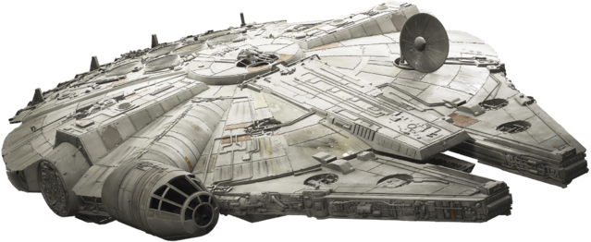

MIKAYLA BARDWELL, CORA HANSEN, MYLES TERRY, AND ALEXIS WEIGEL
SAVE THE EMPIRE
ONE IMPERIAL CREDIT PREDICTION AT A TIME

Slide 2
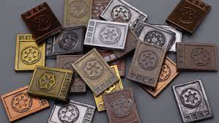


THE PROBLEM
?
KEY MEMBERS OF THE EMPIRE’S ANALYTICS WERE TAKEN CAPTIVE BY THE REBELS
WHO IS GOING TO PREDICT THE IMPERIAL CREDIT FOR THE NEXT 12 MONTHS?!?
WE ARE!!!

Slide 3
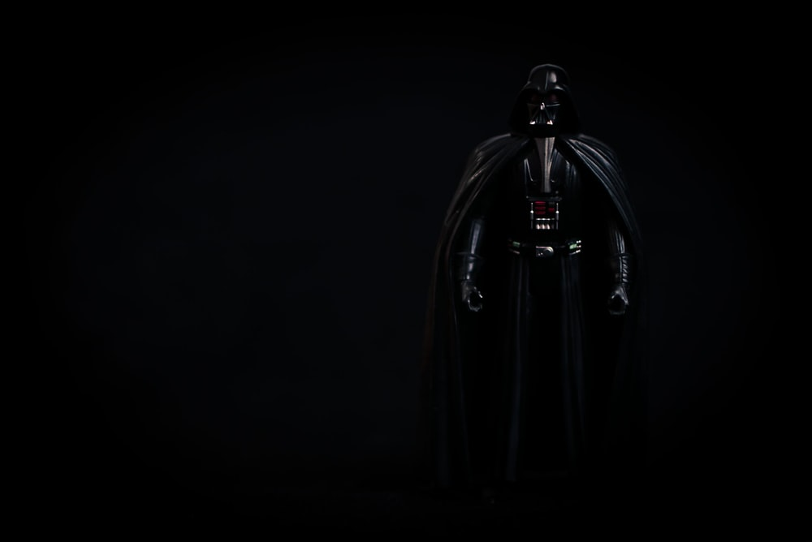
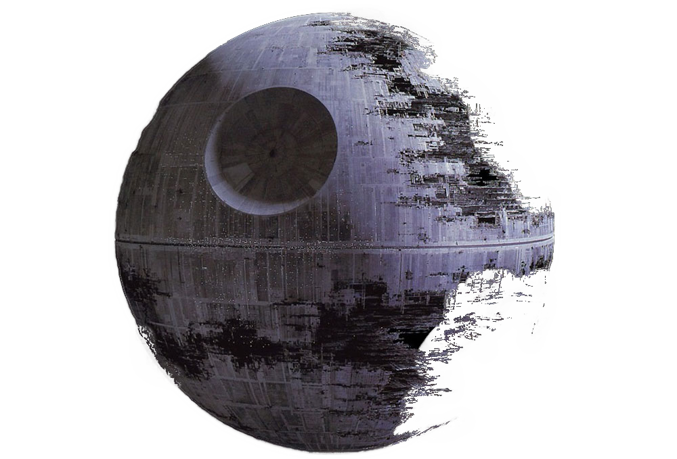
Models that tempted us with the dark side

Slide 4

Models that PRACTICED THE FORCE

Slide 5

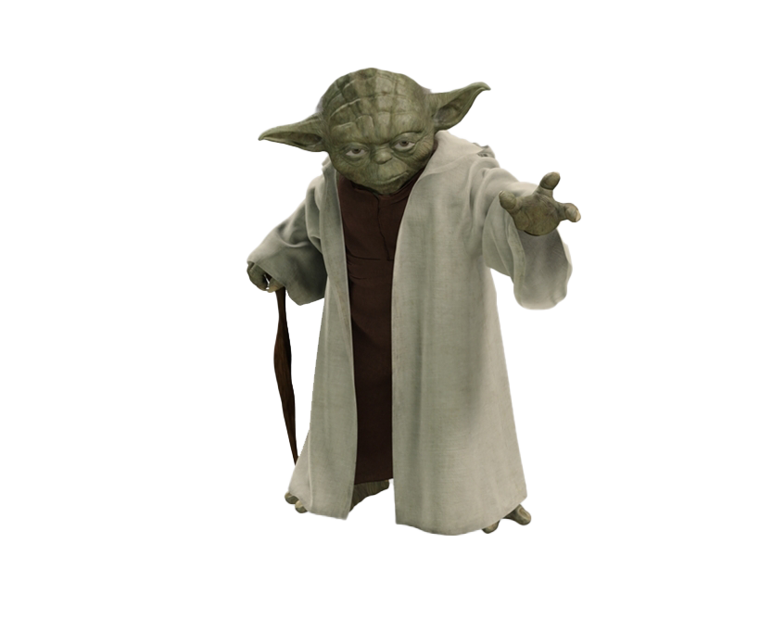
ONE WITH THE FORCE THE MODEL THAT IS

Slide 6



THE GALACTIC EMPIRE WILL LIVE TO PREDICT ANOTHER DAY!

